Slide 1
The Lazy Way to Better Performance
Karen Baney
Senior Consultant
karen.baney@valorepartners.com
https://github.com/kb-coder/lazydemo
Notes:
Introduction to VueJS 2
Valore Partners
Karen Baney
Senior Consultant
Karen.baney@valorepartners.com

Slide 2
My Story
Worked on Vue JS for 3+ years
Client has multiple large scale Vue apps
Started initiative to look at performance and optimization

Slide 3
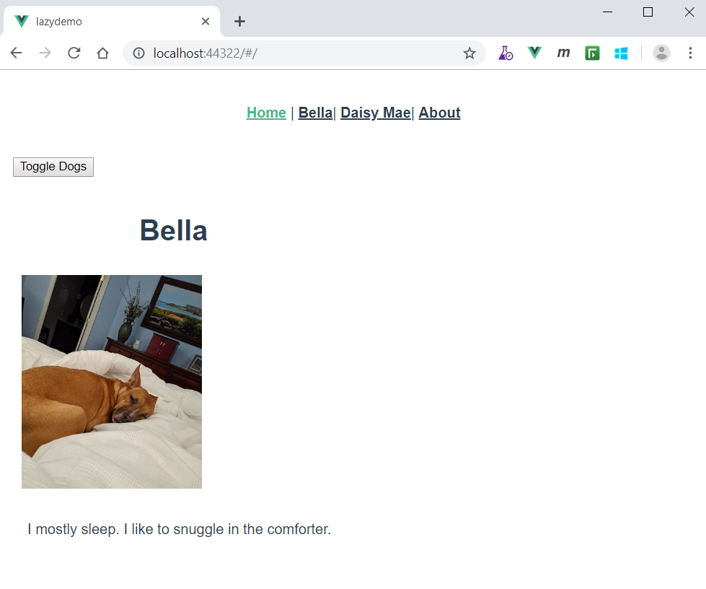
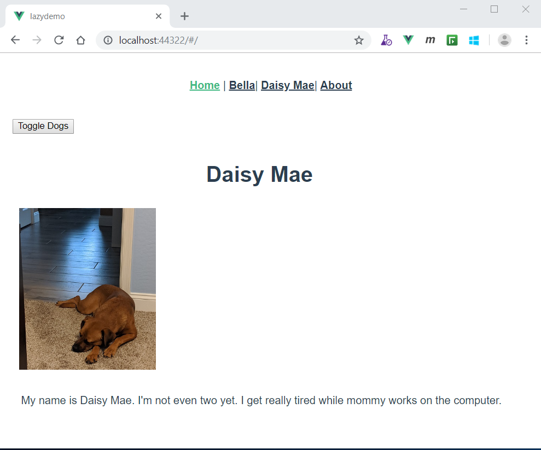
Lazy Demo Site

Slide 4
Lazy Load Components
When component isn’t visible on initial page load
Tabs
Modals
Side Panels
Toggled content

Slide 5
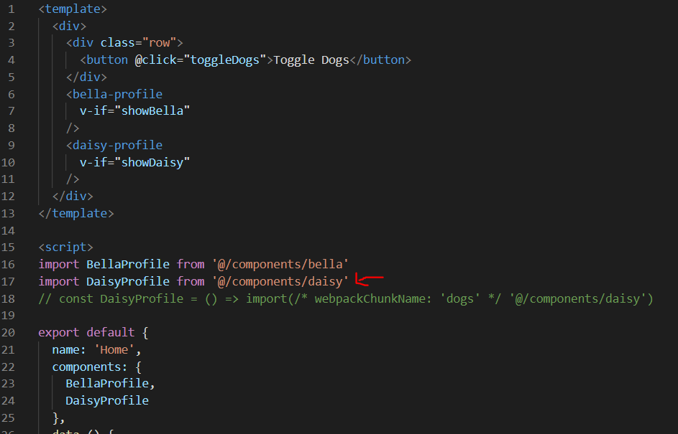

Slide 6
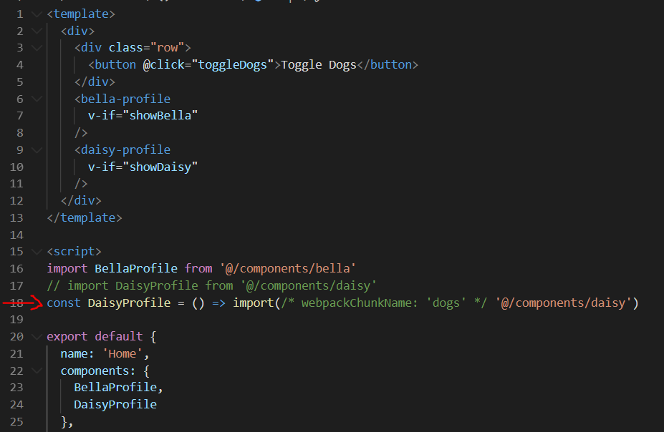

Slide 7
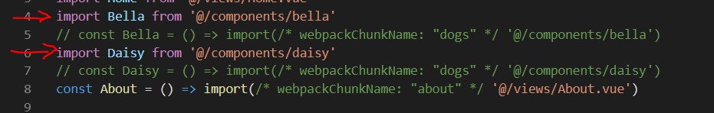

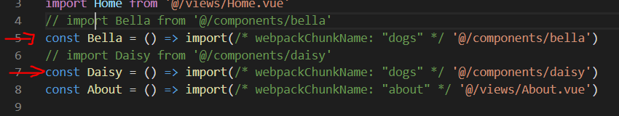
Lazy Loading Routes

Slide 8
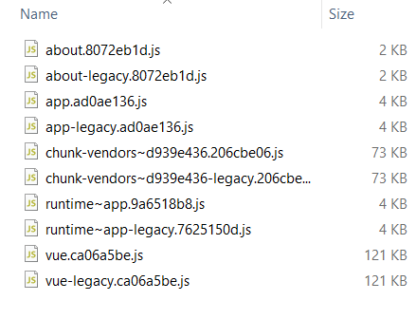
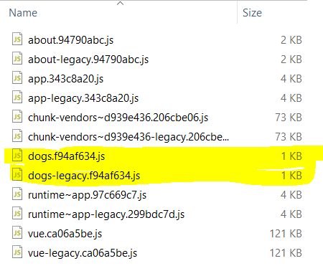
Dist/js
Before
After

Slide 9
Bonus: Code Splitting
vue.config.js
Code splitting out Vue into a separate vendor chunk
Handles preload / prefetch
Shows how to tree shake Moment locales down ‘en-us’ and ‘es-us’
babel.config.js
Settings for tree shaking and for using webpackChunkNames

Slide 10
Karen Baney
karen.baney@valorepartners.com
https://github.com/kb-coder/lazydemo
Thank You!

